Slide 1

Dairy Production and Management
Michael Luwe
Department of Animal Health and Livestock Development

Slide 2
Advantages of Dairy Animals
Milk availability as long as the cow is lactating
Improved nutrition
Stable income from sales
Compliments well in mixed farming
Nutrient recycling
Wastes from crops = feed/bedding
Dung + bedding = manure for crops
High profits with good management
Feeding, disease control, housing

Slide 3
Disadvantages of Dairy Animals
Capital intensive
Purchase of initial stock
Running costs – buckets, cooling system
Buildings, milking yard
Pasture development
Proper management requires training
Disease control
Mastitis chances increase with increased yield
Competition with milk substitutes –e.g soya
However not yet an issue in Mw

Slide 4
Cattle Breeds for Dairy Production
Holstein-Friesian
Jersey
Guernsey
Ayrshire
Brown Swiss
Milking Shorthorns
**Only Holstein-Friesian and Jersey are commonly found in Malawi

Slide 5
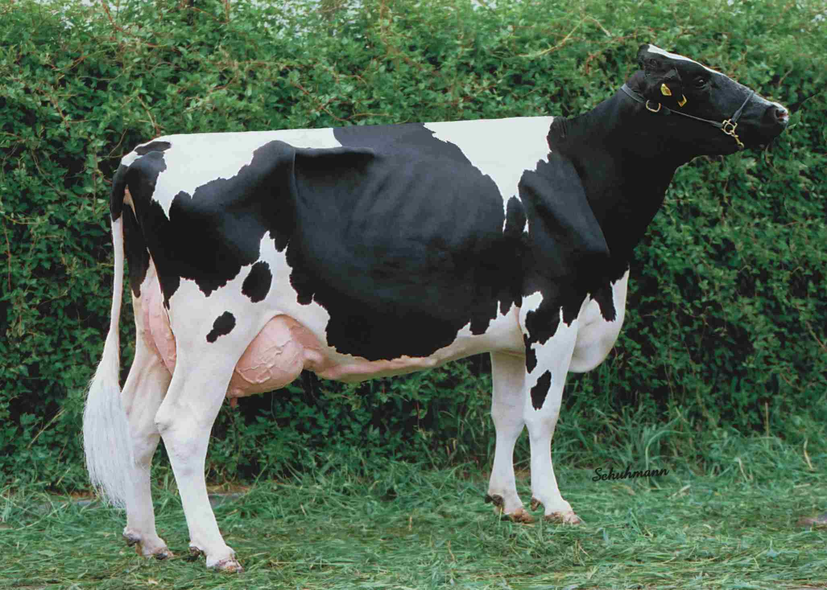
Beef breeds in Malawi
Holstein-Friesian
Breed originated in the Netherlands.
Black and white but a red and white colour may appear occasionally due to the presence of a recessive gene.
They are adaptable to a wide range of conditions.
Holsteins are the largest of the dairy breeds. Mature cows weigh about 680 kg and bulls weigh about 998 kg.
Cows have large udders; and average about 3.5 percent butter fat.

Slide 6
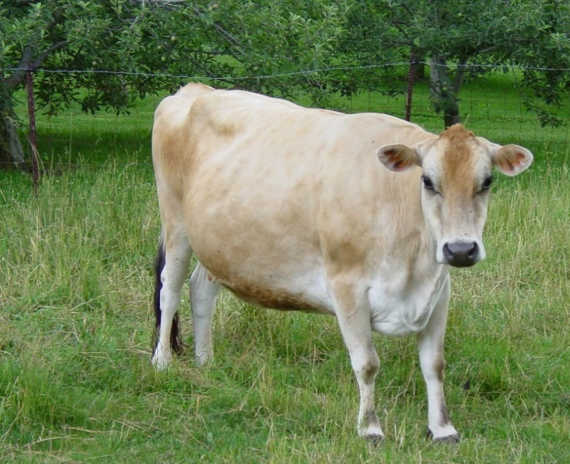
Beef breeds in Malawi
Jersey
Originated on the Isle of Jersey, which is located in the English Channel off the coast of France.
Cream to light fawn to almost black in color.
Smallest of the dairy breeds. Mature cows weigh about 453 kg and bulls weigh about 725 kg.
They average about 5.4 percent milkfat and rank first among the dairy breeds in average milkfat produced per cow.

Slide 7
Lactation Curve and Pregnancy
Peak yield
Milk yield (kg/day)
Lactation curve
Next lactation
Dry period
Foetal Growth
Open period
Pregnant
Gestation period
0
12
40 - 42
52
Calving
Next Calving
Weeks of lactation

Slide 8
Lactation Curve
Milk yield increases gradually after parturition, reaching a peak in about 2 months, and it slowly decreases.
The lactation curve varies with the disposition of animals, seasons at parturition, feeding management, and the number of genetic calving.
Major factors determining the total milk yield in a lactation period are the maximum milk yield, persistency, and the length of the lactation period.
The maximum milk yield increases until 5th to 7th calving, and then decrease gradually.

Slide 9
Performance Cycles
Reproductive cycle
Gestation - 40 weeks
Open period - 12 weeks
52 weeks
Productive cycle
Lactation - 40 weeks
Dry period - 12 weeks
52 weeks

Slide 10
Stages in the Lactation Curve
There are three stages of lactation:
Early lactation (1-5 weeks)
Milk production increases at increasing rate
Mid lactation (6-8 weeks)
peak milk yield
Milk production decreases gradually
Late lactation (Ends at dry off)
Milk production decreases at an increasing rate

Slide 11
Changes of milk composition
Milk quality also changes throughout a lactation period with the change of milk yield.
Milk until about 5 days after parturition is called colostrum, and is remarkably different in composition from normal milk.
Colostrum contains more fat, protein and minerals than normal milk, and less lactose.
Composition of normal milk slightly changes with the progress of lactation period.

Slide 12
Changes of milk composition
Composition | Colostrum | Normal milk
Total solids | 23.9% | 12.9%
Fat | 6.7 | 4.0
Total protein | 14.0 | 3.1
Casein | 4.8 | 2.5
Albumin | 0.9 | 0.5
Immunoglobulin | 6.0 | 0.09
Lactose | 2.7 | 5.0
Ash | 1.11 | 0.74
Folley et al., 1978

Slide 13
Physiological Changes Before and After Parturition in Dairy Cows
With the start of lactation, milk synthesis and increased utilisation of nutrients first occur in the mammary glands.
Then, increased degradation of depot fat occurs in adipose tissue, and there is an increased flux of proteins in the liver and muscles.
In the liver, synthesis of glucose, necessary for milk synthesis becomes active.
In the bones, elution of calcium becomes active, and absorption of calcium from the intestines becomes active with the progress of lactation.

Slide 14
Breeding
Heifers reach sexual maturity at around 15 months of age
Serve them once they reach 18 months of age or attain two-thirds of their mature body weight.
Cows can be served through AI or using bulls.
Duration of estrus in dairy cows is about 18 hours; and ovulation occurs towards the end of estrus.
Inseminate in the evening if heat is first observed in the morning; and morning of the following day if observed in the evening.
If using bull, leave it for 2 days.

Slide 15
Breeding
Chances of conception higher with longer period of rest
Next heat @ 24 – 30 days after calving
Subsequent heats occurs every 21 day
Best time is after 50 days (requires excellent management)
Recommended to serve within 90 days.

Slide 16
Selection of Breeding Animals
Consider parental records (both sire & dam)
Size of animal vs age, do not select those smaller than their age
Cows:
lactation record to decide when to cull
% butter fat content (3.6% average)
Calving interval
Lactation persistency – 305 days vs less (Persistency = rate of decline in milk yield following peak production)

Slide 17
Management of Dairy Calves
Disinfect the navel with 2% diluted iodine.
Continue checking the navel for the next 2 weeks.
Allow the calf to suckle from the dam 24hrs in first 4 days
Thereafter, either leave a quarter (1 teat) for the calf to suckle for 30minutes or bucket feed it.
Bucket feeding not recommended for smallholder farmers.
Bucket feeding:
Not > 10% body wt
Overfeeding, low temp milk causes scouring

Slide 18
Management of Dairy Calves
Introduce roughages & concentrates as soon as possible ~ able to utilise them by 3 weeks of age.
Weaning should be gradual, reduce milk, increase hay & concentrates
Provide plenty of dry bedding.
Calves can be weaned between 6 and 8months

Slide 19
Management of Cows and Heifers
Ensure pastures contain legumes
Level of supplement depends on:
Season (better feed quality in rainy season)
Stage of gestation
Amount of milk produced
Use feeding standards available in most nutrition books
Formulate feed (12-16% CP & minerals – salt, phosphorus, calcium)
Dairy & calf mashes available

Slide 20
Management of Cows and Heifers
Cattle are limited on total dry matter intake by body size
Cattle (ruminants) require substantial fibre in their diet.
Forages should constitute at least ½ of daily ration on dry matter basis.
Milk is 87% water hence provision of plenty of clean, fresh, water ad lib. Cow needs 5litres of water for every 1 litre of milk.
As the level of milk production rises,
Cow must eat more feed or the feed must contain more nutrients per unit weight

Slide 21
Management of Cows and Heifers
Rule of the thumb: 23 – 30% of the diet should be composed of protein ingredients and 60 – 79% energy ingredients and a small amount if salt and minerals.
For example, a 100kg home made ration:
Source | Ingredient | Quantity
Energy | Maize bran or Rice bran | 79kg
Protein | Soybean, Cotton seed cake, Peas, G/nuts, Leucaena leaves or Sesbania leaves | 20kg
Mineral | Salt | 1kg

Slide 22
Management of Cows and Heifers
It is recommended that 1Kg concentrates be given to the cow per 2 litres of milk produced in addition to what the cow needs for maintenance
Too high energy content of the ration with too low roughage – causes acidosis.
Require regular handling so that they get used to people.
Observe routine e.g. milking, feeding time
Need to exercise confined animals.
Control of internal and external parasites (drenching and dipping)

Slide 23
Challenge Feeding
Cow is "challenged" to produce more milk by increasing concentrates
Grain amounts are then increased until production no longer increases
Grain amounts are then adjusted according to milk production
Maximum production may not always be the most economical, especially on cows that are not real efficient feed converters or when grain prices are high.
A cow's response to challenge feeding is best in early lactation.

Slide 24
Housing
The corral should be built on well drained soils.
Provide shelter to protect it from rain, wind, sun and predators.
Sloping side of the roof should face the direction of the prevailing winds. Put up drains to prevent water from going into the corral.
Corral should have a cow compartment, calf compartment, milking parlour, exercise yard and a crush.
Feed and water troughs should also be provided.

Slide 25
Housing
Corral size: Two cows would require a corral of 3.7m wide, 6.1m long and 2.4m high. Each cow requires 9.3m² and a calf need 2.3m².
Milking parlour:
should be upwind from spray crush to avoid contamination with acaricides (dip).
Walls can be constructed from reeds, poles, mud or brick and the roof be made of thatched grass.
Crush: This is required for inspection, treatment, and handling. It should be constructed away from the Khola, in a dry place.
Vertical = 1200mm high x 610mm x 680mm

Slide 26
Dehorning
Horns are usually removed to prevent injury to other cattle and to handlers.
It is best done when calves are under 3 months old as this will not cause no setbacks (normally between 3 – 4 weeks).
Common methods of dehorning include:
Hot iron
Dehorning knife
Scoop or cup dehorners
Hand saw – older cattle
Chemical : Liquid, paste, or caustic potash sticks – calves under 2 weeks

Slide 27
Record Keeping
Every cow has its own card, on which the sire (bull) and dam (cow) are noted.
Further it notes:
date of birth of the cow
dates of heat
dates of service
expected calving date
true calving date
calving interval
total milk production per lactation

Slide 28
Herd Health
The key to the success of the health plan is the prevention of problems.
Being familiar with the diseases and parasites that affect beef cattle can help farmers plan preventive programs that reduce health problems and increase profits.
Observing the vital signs (temperature, pulse rate, and respiration rate) in an animal can help in the early detection of health problems.
temperature (normal range is 38°C to 39.3°C).
pulse rate (normal range is 60 to 70 heartbeats per minute).
respiration rate (normal range is 10 to 30 breaths per minute).

